Slide 1
Capstone Project – 4
Start-up Funding Prediction

Slide 2






Is this startup ready for funding?Let’s find out!
1
3
5
Understanding the Problem statement & domain research
Feature Engineering
Revisiting the
Problem
Data Cleaning, Visualization & Exploratory Data Analysis
Conclusion
Applying ML Algorithms
2
4
6

Slide 3

Apprehending the goal!
There has been a staggering growth in investments in young age startups in the last 5 years. A lot of big VC firms are increasingly getting interested in the startup funding space. We are given a task to predict whether a startup will get a funding in the next three months using app traction data and startup details.

Slide 4

Data Pallete
General Features
UUID- (Unique Identifier)
Month
Application Category
Avg Session Time
Total Session Time
Open Rate
Reach
Funding Ind
Features for funded
Start-ups
Business models
City
Company Stage
Founded year
Latest funded date
Monthly Active Users
Total Funding
Uninstall Rate

Slide 5
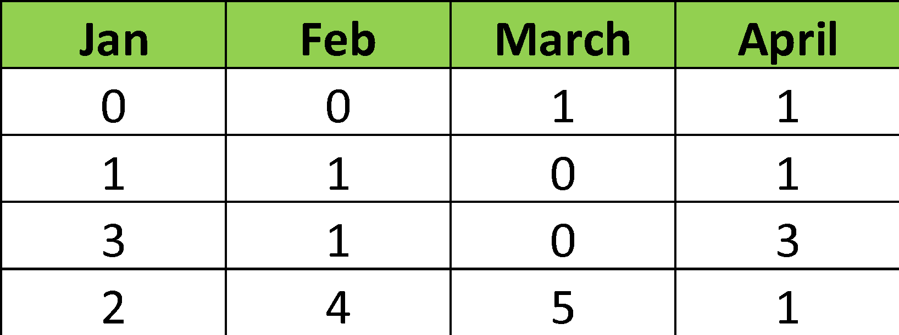
Approaching the Problem
Training month
Dropped the features which were only provided for funded startups.
Taking entire dataset.
As, we want to predict whether start-up will be funded in next 3 months, we took the last 3 months as prediction months and made the month before 3 months as th training month.
Prediction months

Slide 6
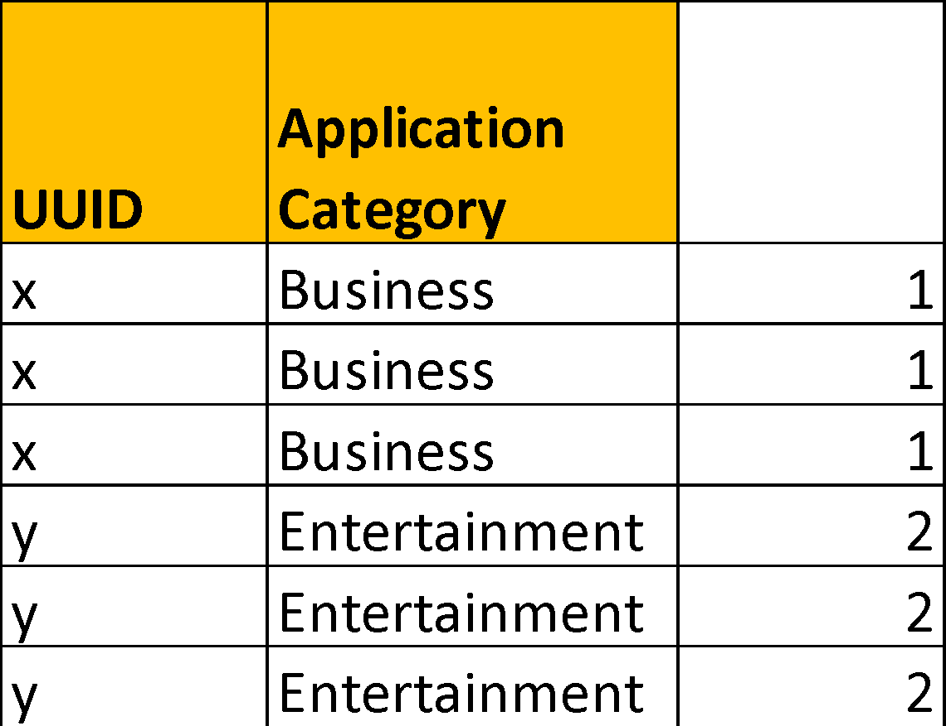
Data Cleaning
UUID with count less than 4
Removing features that were only present for Funded startups & Missing Values Imputation
According to the approach discussed above, UUID with less that 4 months data is removed
Imputing missing values by creating a class that would go for each UUID then by Category and apply back fill(limit-1) & forward fill(limit-1) and remaining with mean of that UUID and category.
Removing Duplicates
No. of Duplicates: 89412
Initial Data size
(1502175, 20)

Slide 7
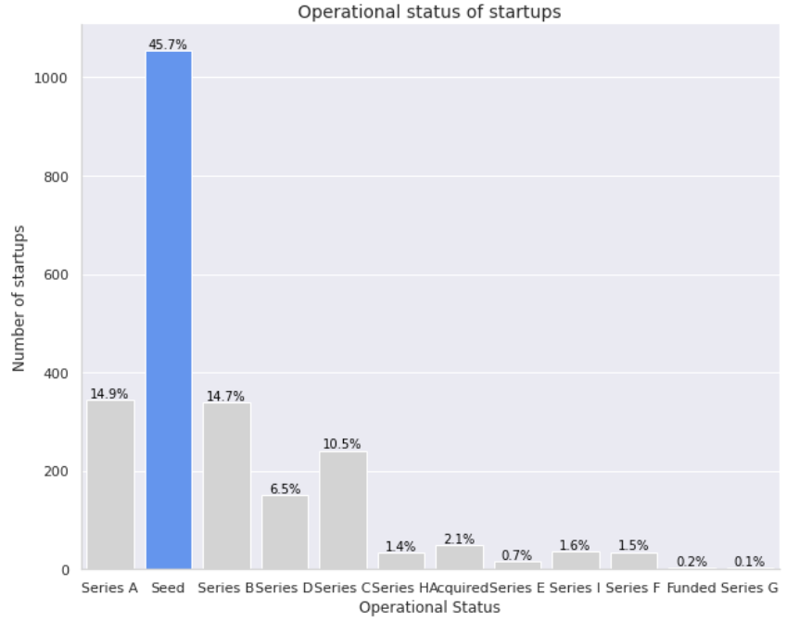
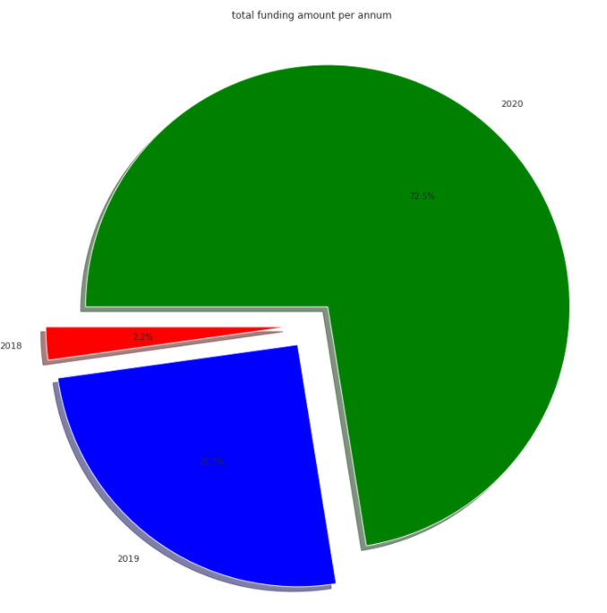
Exploratory Data Analysis

Slide 8

Exploratory Data Analysis

Slide 9
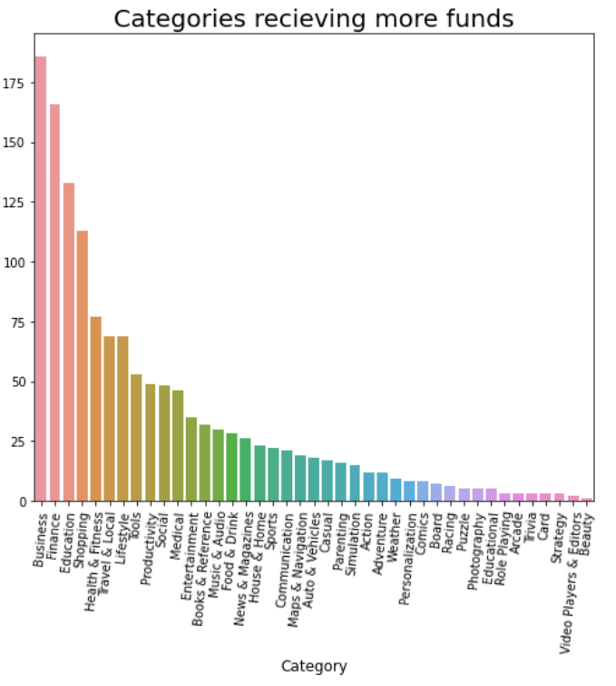
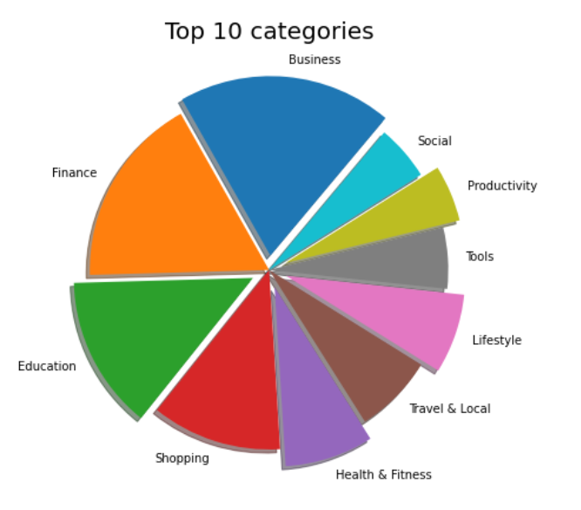
Exploratory Data Analysis

Slide 10
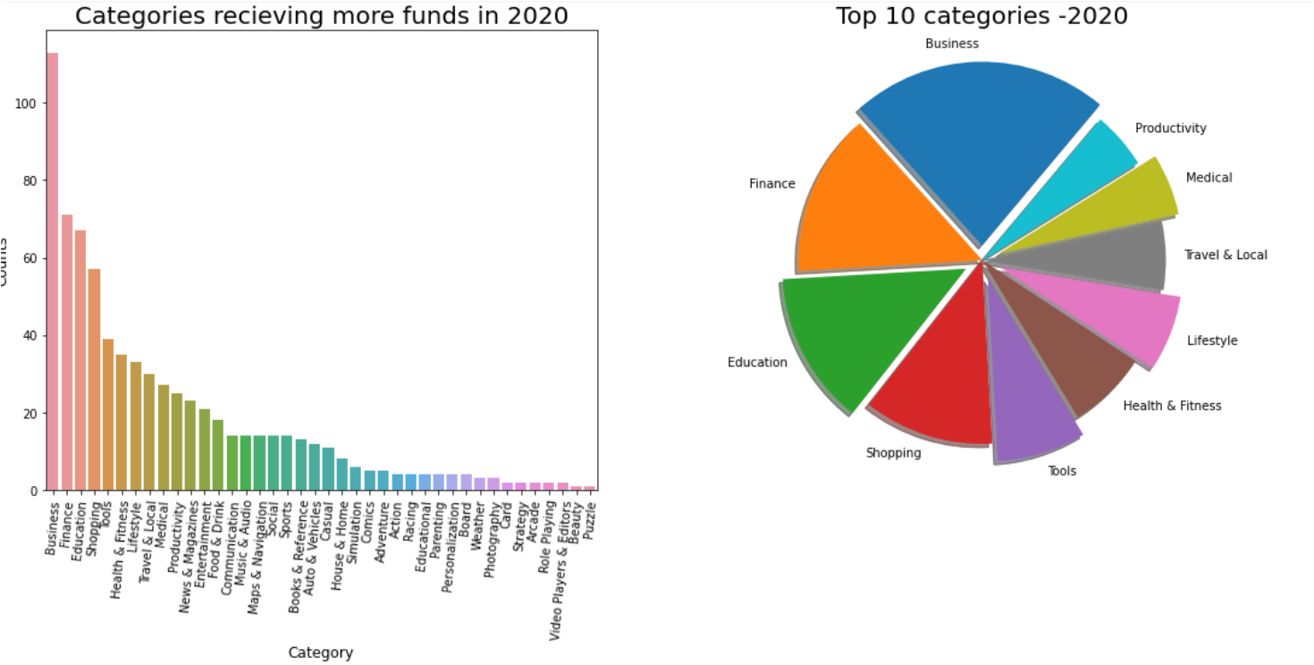
Exploratory Data Analysis

Slide 11
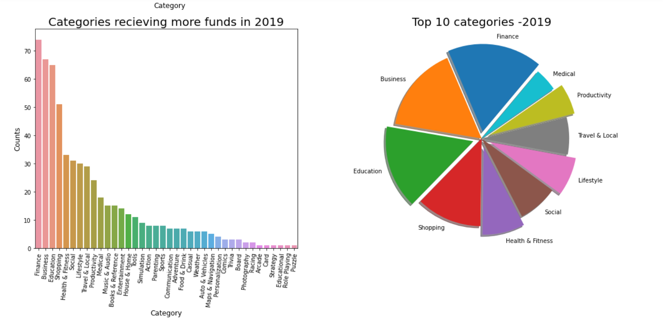
Exploratory Data Analysis

Slide 12
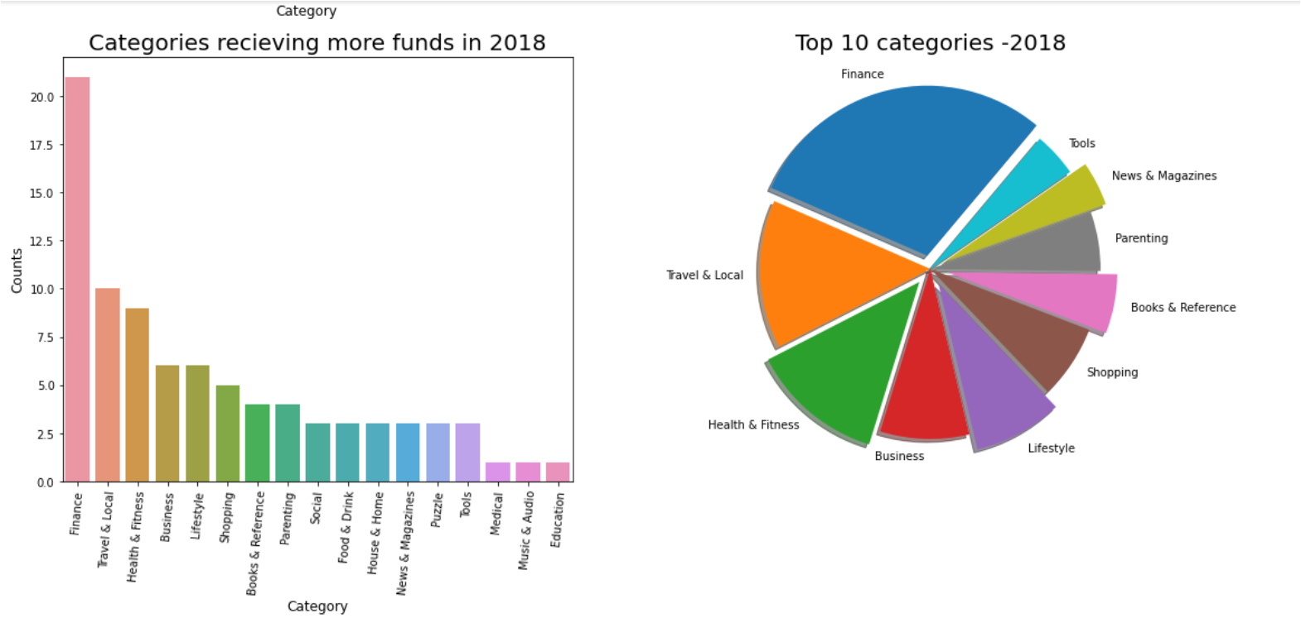
Exploratory Data Analysis

Slide 13
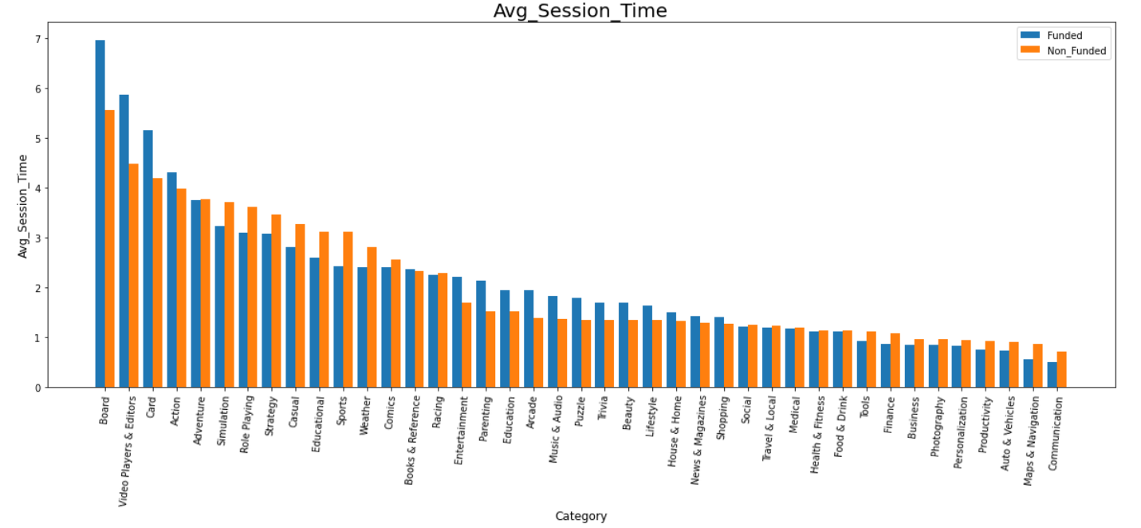
Exploratory Data Analysis

Slide 14
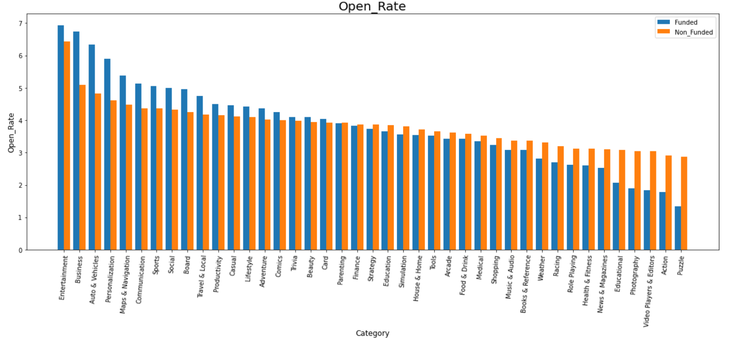
Exploratory Data Analysis

Slide 15
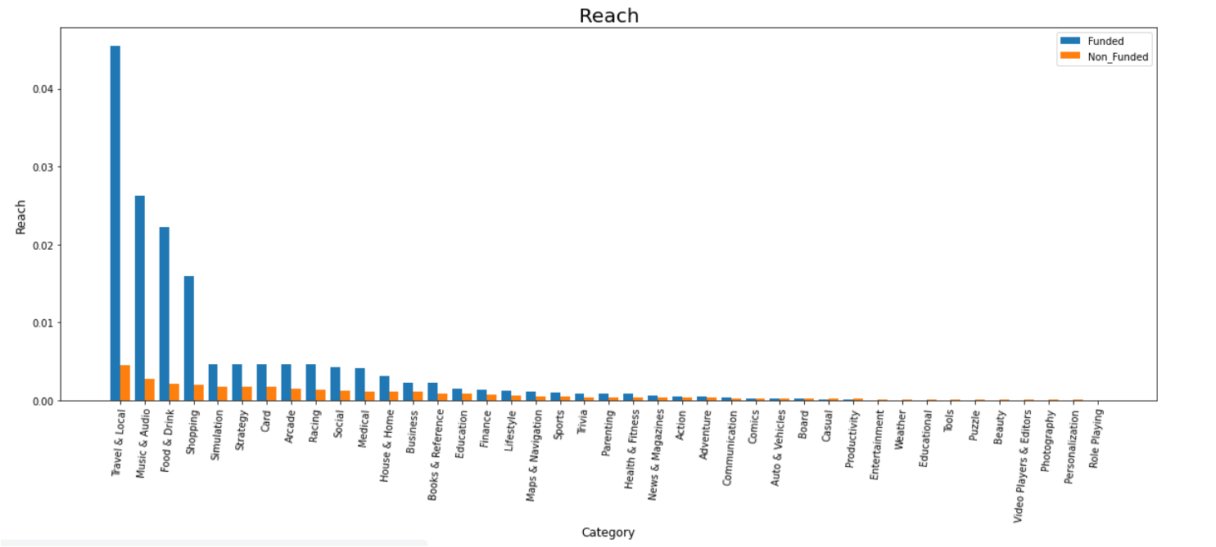
Exploratory Data Analysis

Slide 16
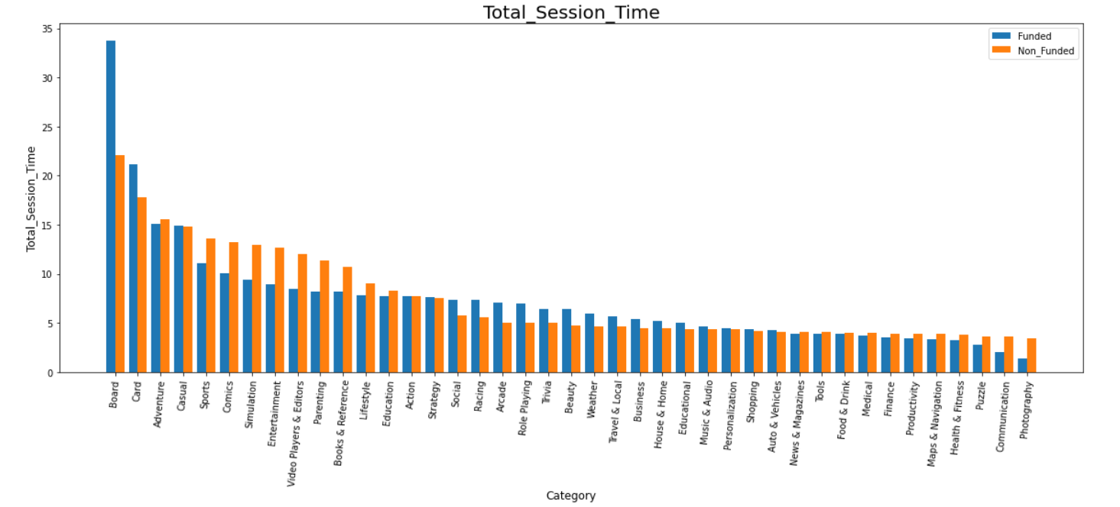
Exploratory Data Analysis

Slide 17

Feature Engineering
Avg_Session_Time_Prev3 : The average session time upto 3rd last month.
Open_Rate_Prev3 : The open rate upto 3rd last month.
Reach_Prev3 : The reach upto 3rd last month.
Total_Session_Time_Prev3 : The total session time upto 3rd last month.

Slide 18
Feature Engineering(Contd.)
Avg_Session_Time_change_3 : The expected change in average session time after 3 months.
Avg_Session_Time_change_2 : The expected change in average session time after 2 months.
Avg_Session_Time_change_1 : The expected change in average session time after 1 month.
Open_Rate_change_3 :The expected change in open rate after 3 months.
Open_Rate_change_2 : The expected change in open rate after 2 months.

Slide 19
Feature Engineering(Contd.)
Open_Rate_change_1 : The expected change in open rate after 1 month.
Reach_change_3 : The expected change in Reach after 3 months.
Reach_change_2 : The expected change in Reach after 2 months.
Reach_change_1 : The expected change in Reach after 1 month.
Total_Session_Time_change_3 : The expected change in total session time after 3 months.

Slide 20
Feature Engineering(Contd.)
Total_Session_Time_change_2 : The expected change in total session time after 2 months.
Total_Session_Time_change_1 : The expected change in total session time after 1 month.
Times_Funded_prev : Number of time the startup got funded earlier.
Investor_Interest : The percentage of interest ,the investor shows.
Funded : Dependent variable indicating whether startup will get funded in next 3 months.

Slide 21

Data Pre-processing for Model
(112432,21)
SMOTE
SMOTENC
(224862,21)
.

Slide 22
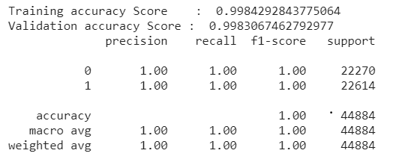
Applying ML Algorithms
Stochastic Gradient Descent

Slide 23
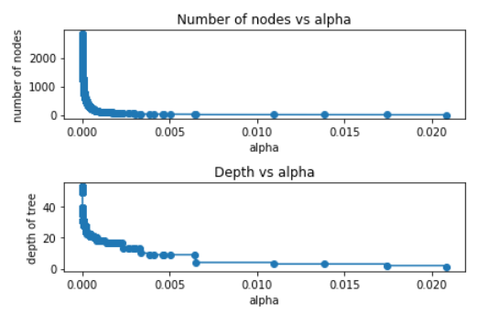
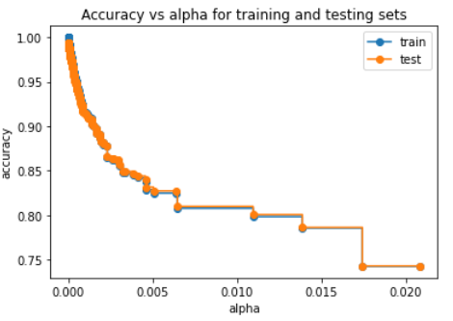
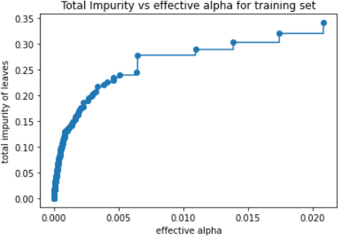
Applying ML Algorithms
Decision Tree Classifier(Cost Complexity Pruning)

Slide 24
Applying ML Algorithms
Performance of Decision Tree Classifier
Performance of Gradient Boosting Classifier
Performance of XG Boost Classifier

Slide 25
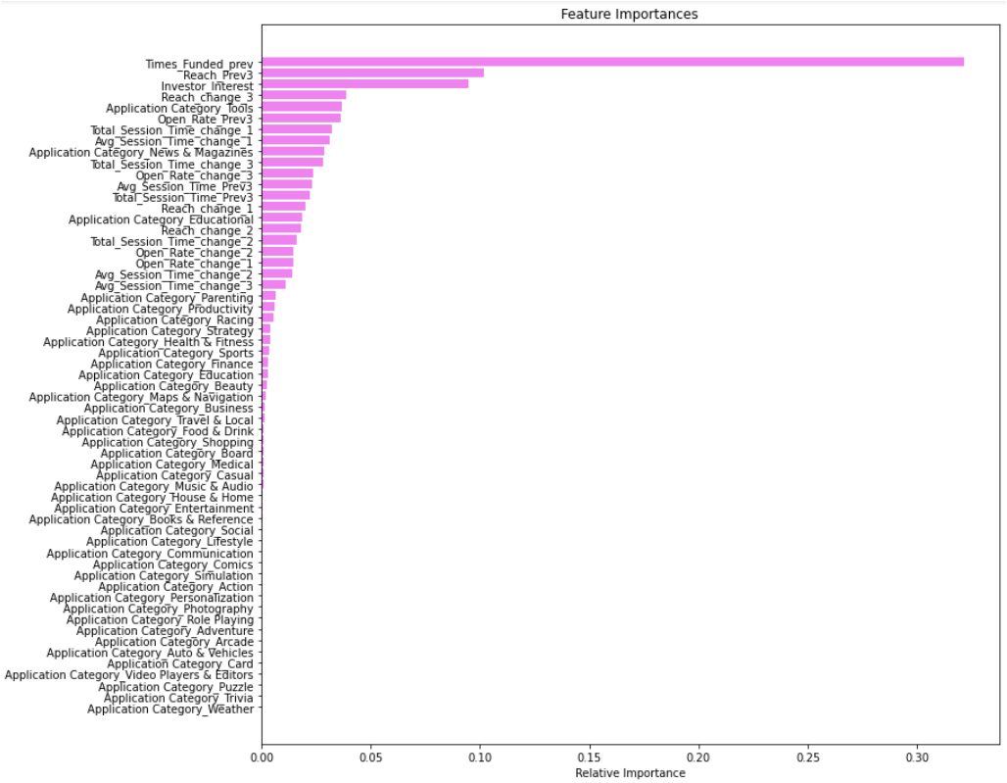
Feature Importance

Slide 26
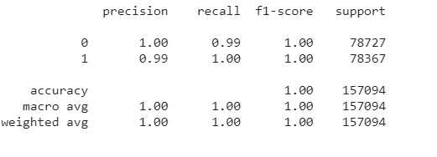
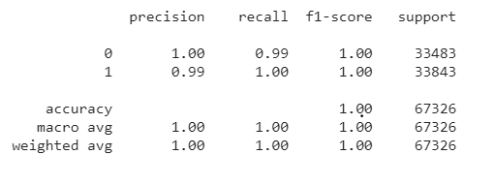
Cat Boost
Training Classification Report
Test Classification Report

Slide 27
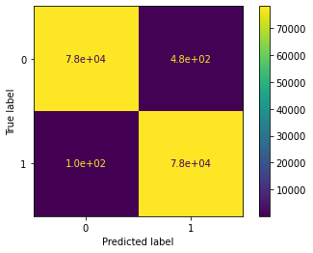
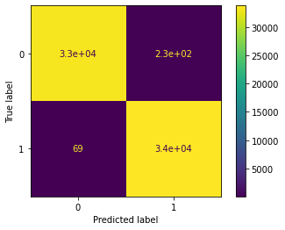
Cat Boost
Confusion Matrix for Training data
Confusion Matrix for Test data
[78242, 485],
[ 105, 78262]
[33252, 231],
[ 69, 33774]

Slide 28
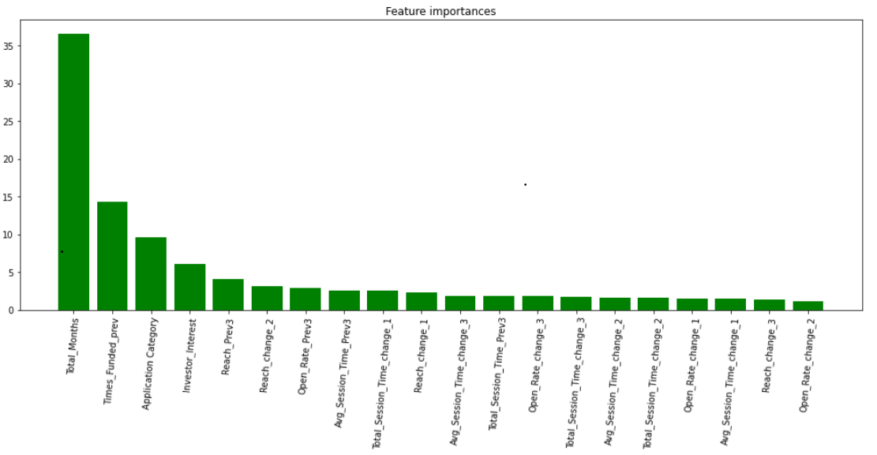
Cat Boost

Slide 29
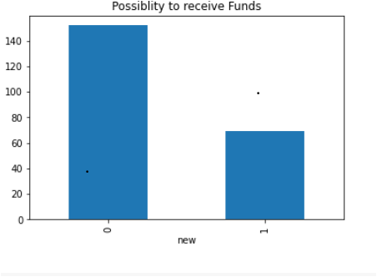
Revisiting the Problem
Periodic Investment
Apply with other Domain/ Category
Age of company
Relations with investors
Considering other features while investing more than once.
Funded Prev
Never Funded

Slide 30
Never Funded (Cat Boost)
Training Classification Report
Test Classification Report
precision recall f1-score support
0 1.00 0.99 1.00 78412
1 0.99 1.00 1.00 78180
accuracy 1.00 156592
macro avg 1.00 1.00 1.00 156592
weighted avg 1.00 1.00 1.00 156592
precision recall f1-score support
0 1.00 0.99 1.00 33440
1 0.99 1.00 1.00 33672
accuracy 1.00 67112
macro avg 1.00 1.00 1.00 67112
weighted avg 1.00 1.00 1.00 67112

Slide 31


Never Funded (Cat Boost)
Confusion Matrix for Training data
Confusion Matrix for Test data
[77921, 491],
[ 79, 78101]
[33170, 270],
[ 52, 33620]

Slide 32
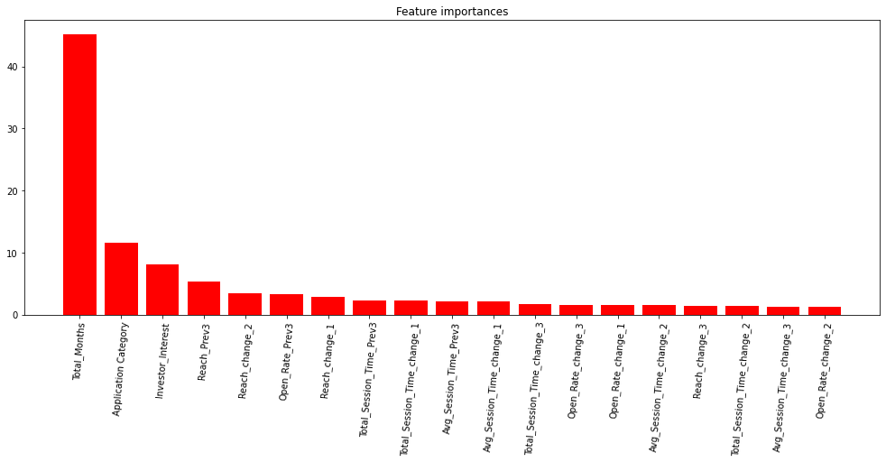
Feature Importance

Slide 33
Funded Previously (Cat Boost)
Training Classification Report
Test Classification Report
precision recall f1-score support
0 1.00 1.00 1.00 245
1 1.00 1.00 1.00 256
accuracy 1.00 501
macro avg 1.00 1.00 1.00 501
weighted avg 1.00 1.00 1.00 501
precision recall f1-score support
0 0.96 0.96 0.96 113
1 0.96 0.96 0.96 102
accuracy 0.96 215
macro avg 0.96 0.96 0.96 215
weighted avg 0.96 0.96 0.96 215

Slide 34
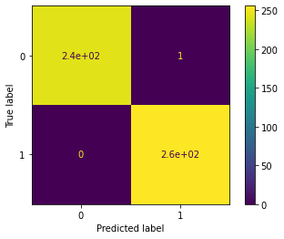
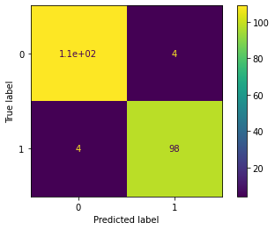
Funded Previously (Cat Boost)
Confusion Matrix for Training data
Confusion Matrix for Test data
[244, 1],
[ 0, 256]
[109, 4],
[ 4, 98]

Slide 35
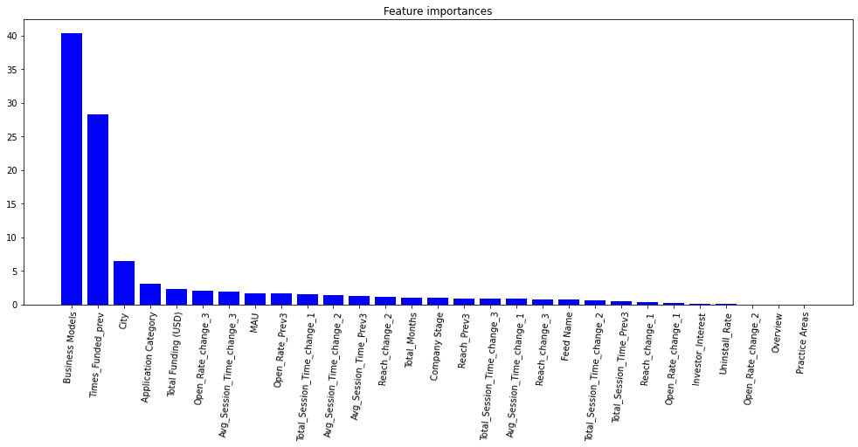
Feature Importance

Slide 36
Conclusion
As the Exploratory Data Analysis suggests,maximum seeding funding is given to startups.
In the year, 2020 total amount of funding was maximum.
The Category which got funding for maximum number of times was Education.
Maximum funding was given to Bangalore based startups.
As we had other more feature for startups that were funded once, for this problem we suggest to build two separate ML systems. (Even can do multiclass classification)
Cat Boost was performing well overall. So optimal model would be same for both ML systems.
As

Slide 37
Challenges
The dataset was too large to handle.
There were plenty of missing values.
We had to build relevant features to approach the problem statement.
As the dataset was very large, it took great deal of time to prepare the training dataset.
Due to lack of time we were unable to make good model for startups that were already funded.
D

Slide 38
Q & A

